Slide 1
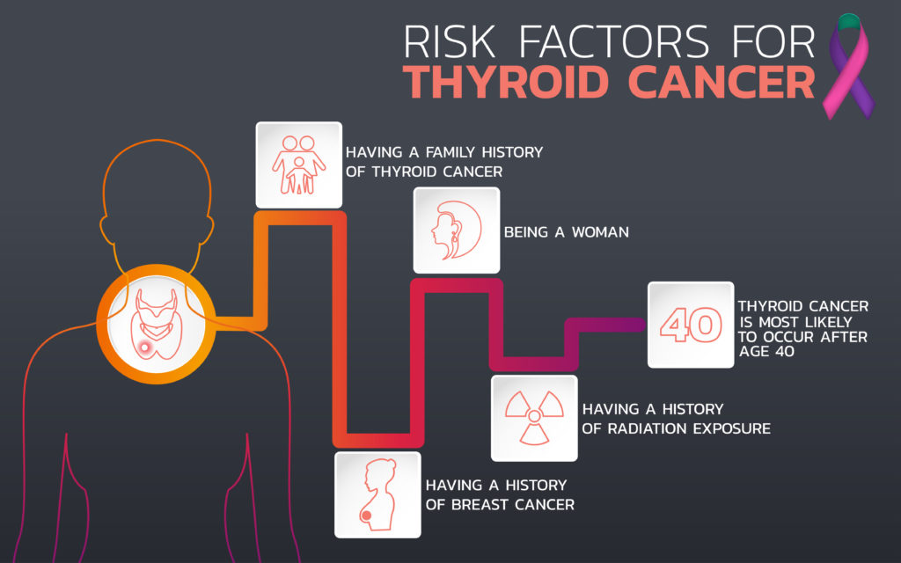
Predictive Modeling and Risk Analysis of Thyroid Cancer Using SAS
Present by: Yasika Sawant
Course: ECON 5475 Applied Econometrics and Analyst
Instructor: Dr. William J. Smith
Date: 05/13/2025

Slide 2

Overview:
Introduction
Literature Review
Dataset & Methodology
Data Description
Result
Analysis
Conclusion
SAS Code

Slide 3


Introduction :
Thyroid cancer is one of the fastest-growing cancer types globally, and early detection is critical for effective treatment. In this project, the aimed is to analyze a healthcare dataset to identify potential risk factors associated with thyroid cancer. By exploring patient demographics, lifestyle habits, and clinical indicators, I build a model that accurately predicts high-risk individuals.
The procedures begin by importing and cleaning the dataset using SAS, transforming categorical variables into binary format and defining a clear target variable for cancer risk. Exploratory data analysis was conducted to understand distributions and relationships among variables. This included generating descriptive statistics and visualizing frequency distributions across gender, age groups, country, and ethnicity.
For predictive modeling, the logistic regression is applied with stepwise selection to identify significant predictors of thyroid cancer risk. Additionally, a random forest model was used to improve classification accuracy. Model performance was assessed using ROC curves and probability visualizations. The insights from this project can help support early diagnosis efforts and inform healthcare strategies targeting at-risk populations.

Slide 4


Literature Review :
1. Study by Ahn et al. (2014)
Title: Predictive Factors for Thyroid Cancer Using Ultrasonographic and Laboratory Features Findings:
Higher TSH levels were significantly associated with an increased risk of thyroid malignancy.
Larger nodule sizes and being female also showed a strong correlation with cancer risk.
The study concluded that TSH level is a strong independent predictor and should be considered during diagnostic assessments.
Logistic regression produced a good predictive model for differentiating between benign and malignant thyroid nodules.
2. Study by Kim et al. (2017)
Title: Association Between Lifestyle Risk Factors and Thyroid Cancer: A Population-Based Study Findings:
Radiation exposure, obesity, and positive family history were significantly associated with higher thyroid cancer risk.
Smoking showed an inverse relationship, with smokers having a slightly lower incidence though this was interpreted cautiously due to potential confounders.
The authors emphasized the importance of lifestyle and environmental factors in cancer risk and recommended public health interventions for prevention.
3. Study by Sadeghi et al. (2020)
Title: Application of Machine Learning for Predicting Thyroid Cancer Risk Using Medical Data Findings:
The random forest model outperformed other models like logistic regression and support vector machines in accuracy and sensitivity.
Key predictors identified included TSH levels, iodine deficiency, obesity, and smoking.
The study demonstrated that machine learning models can effectively predict thyroid cancer risk when trained on well-structured healthcare data.
It highlighted the usefulness of ensemble methods in capturing non-linear relationships in medical diagnostics.

Slide 5
Dataset and Methodology :
Dataset Overview
Number of Observations: 212691
Total Columns: 17
Identifiers & Demographics
Methodology Summary
1. Tools Used: SAS(PROC IMPORT,DATA STEP, PROC LOGISTICS, PROC HPFOREST)
Type: Multivariate Healthcare Dataset
Goal: Predict Thyroid_Cancer_Risk (High vs. Low/Medium)
Patient_ID: Unique identifier (not used in modeling)
Age: Continuous numeric
Gender, Country, Ethnicity: Categorical
Medical History & Lifestyle (Categorical — mostly Yes/No)
Family_History
Radiation_Exposure
Iodine_Deficiency
Smoking
Obesity
Diabetes
Lab & Clinical Measures (Numeric)
TSH_Level (Thyroid Stimulating Hormone)
T3_Level, T4_Level: Thyroid hormones
Nodule_Size: Tumor or gland nodule dimension
Target & Diagnosis
Thyroid_Cancer_Risk: Target variable — High vs. Low/Medium
Diagnosis: Actual medical outcome (can be used for validation or comparison)
2. Data Preprocessing
Categorical variables encoded into binary (e.g., Male = 1, Yes = 1)
Created a binary target variable: Risk = 1 if High, else 0
3. Exploratory Data Analysis
Descriptive stats for continuous features using PROC MEANS
Frequency distributions using PROC FREQ
Cross-tabulations by Age Group, Gender, Country, etc.
4. Modeling Approaches
OLS Regression: For understanding variable relationships
Logistic Regression: With stepwise selection to identify key risk factors
Random Forest (PROC HPFOREST): For improved prediction using ensemble learning
5. Model Evaluation
ROC curve analysis to evaluate classification performance
Predicted vs. Actual risk visualization
Variables

Slide 6
Data Description:
Variable Name | Type | Description
Patient_ID | Identifier | Unique ID assigned to each patient (not used in analysis)
Age | Continuous | Age of the patient
Gender | Categorical | Biological sex of the patient (Male/Female)
Country | Categorical | Country of residence
Ethnicity | Categorical | Ethnic background
Family_History | Binary | Family history of thyroid cancer (Yes/No)
Radiation_Exposure | Binary | Whether the patient has had exposure to radiation (Yes/No)
Iodine_Deficiency | Binary | Indicates iodine deficiency (Yes/No)
Smoking | Binary | Smoking habits of the patient (Yes/No)
Obesity | Binary | Obesity status of the patient (Yes/No)
Diabetes | Binary | Diabetes condition (Yes/No)
TSH_Level | Continuous | Thyroid Stimulating Hormone level
T3_Level | Continuous | Triiodothyronine level
T4_Level | Continuous | Thyroxine level
Nodule_Size | Continuous | Size of the thyroid nodule
Thyroid_Cancer_Risk | Categorical | Risk level classified as High, Medium, or Low
Diagnosis | Categorical | Clinical diagnosis or outcome
The dataset comprises healthcare records of patients with features related to demographic details, lifestyle habits, medical history, and biochemical indicators. It is used to analyze and predict the risk of thyroid cancer.
Variables and Their Description:
Dependent Variable:
Thyroid_Cancer_Risk (converted to binary: High = 1, Low/Medium = 0)
Independent Variables:
Demographic: Age, Gender, Country, Ethnicity
Medical/Lifestyle: Family_History,
Radiation_Exposure, Smoking, Obesity,
Diabetes, Iodine_Deficiency
Lab Measures: TSH_Level, T3_Level,
T4_Level, Nodule_Size

Slide 7
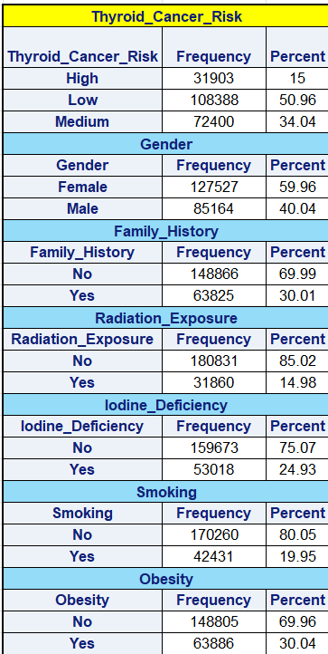
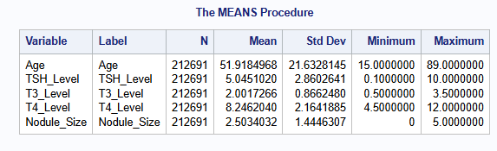
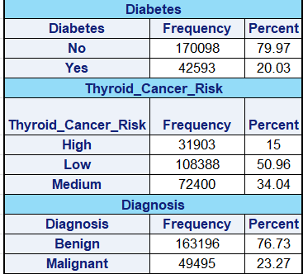
Analysis and Results:
Freq Procedures:
Most patients were female, and a significant number had a family history of thyroid issues.
Thyroid Cancer Risk was classified into High, Medium, and Low. ~15% were in the High-Risk group.
Descriptive Analysis: The average patient’s age was around 50+, nodule sizes varied widely, and thyroid hormone levels showed noticeable variability.

Slide 8
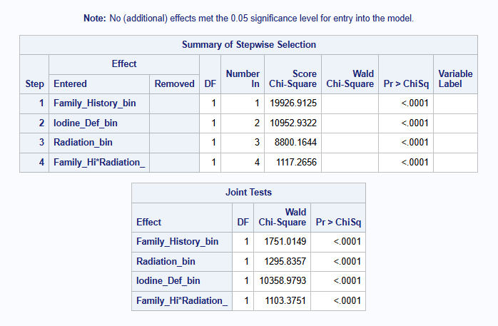
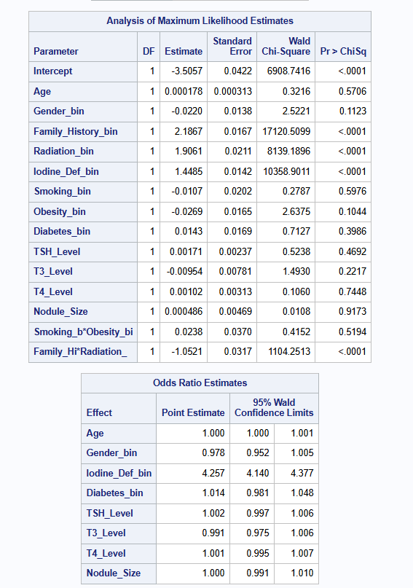
Analysis and Results:
Logistic Regression (PROC LOGISTIC with STEPWISE) : Statistically significant predictors: Iodine deficiency, Family hi*radiation, Radiation, and Family History

Slide 9
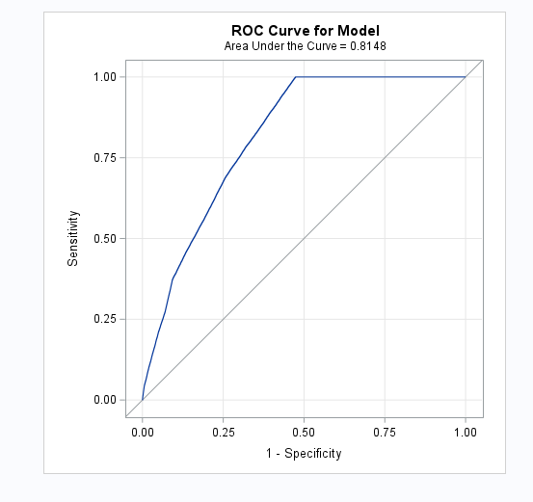
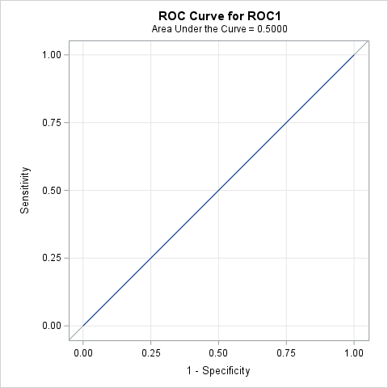
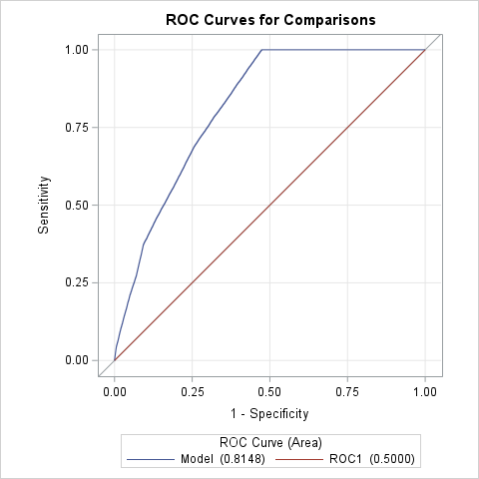
Model Evaluations :
ROC Curve: The AUC(Area Under the Curve) is above 0.80, which means the model is performing well and can reliably classify high-risk individuals

Slide 10
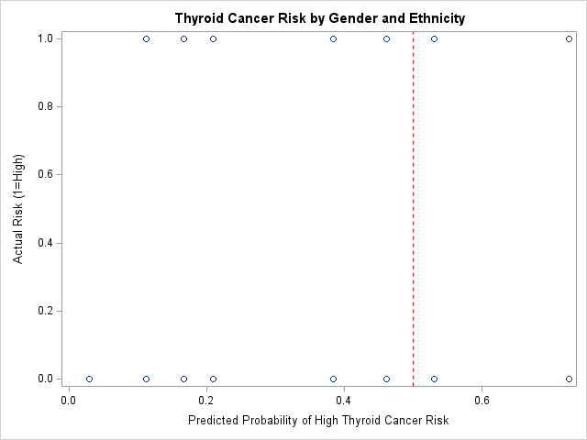
Visualization of Predicted Probabilities :
Used PROC SGPLOT to scatter plot actual vs. predicted risk
The red dashed reference line at 0.5 shows the decision threshold
Helps interpret how well the model classifies high-risk cases
Showed how predicted probabilities of high risk varied across individuals, with a clear threshold around 0.5 for classifying high risk.

Slide 11
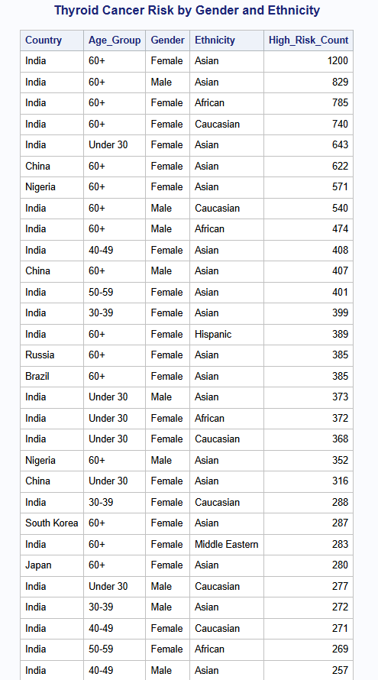
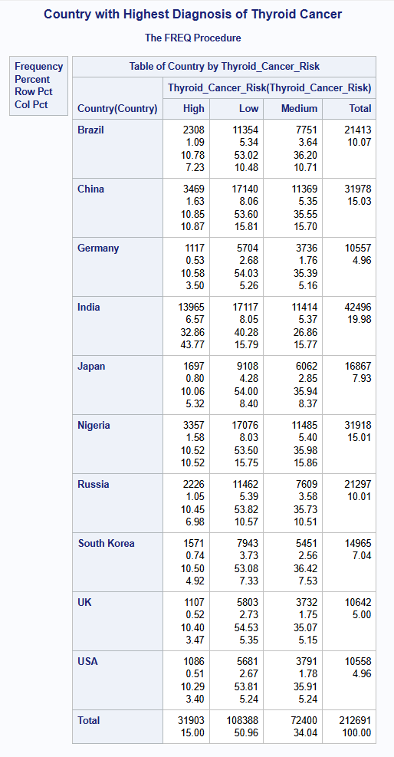
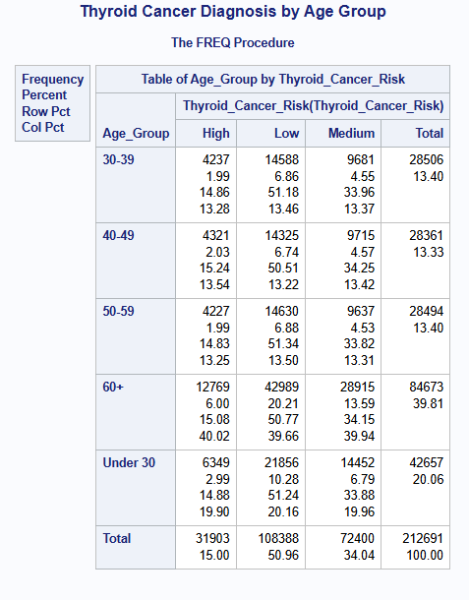
Group Level Analysis:

Slide 12
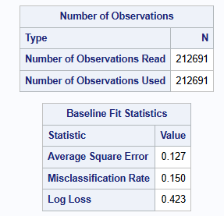
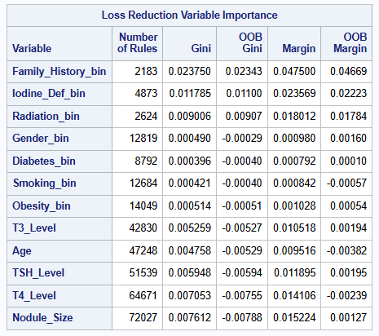
Random Forest :
Interpretation:
Family history is the strongest predictor in model, followed by iodine deficiency.
This aligns with medical understanding that family history and iodine levels are significant risk factors.

Slide 13

Conclusion :
This project aimed to predict thyroid cancer risk by analyzing a large and diverse dataset of over 212,000 patient records using advanced statistical and machine learning techniques. The approach combined descriptive analytics, regression modeling, and a high-performance random forest (HPFOREST) algorithm in SAS to derive clinical insights and build a robust predictive model.
Key Findings:
Descriptive Analysis revealed that patients with a family history of thyroid disease, those exposed to radiation, and those with abnormal hormone levels (TSH, T3, T4) had higher likelihoods of being in the high-risk group. Females and patients aged 40–60+ also showed elevated risk.
Logistic Regression identified, Radiation Exposure, Iodine deficiency and Family History as statistically significant predictors of cancer risk. Interaction effects (e.g., Obesity × Smoking) amplified risk in specific subgroups.
Model Evaluation confirmed strong classification performance. The ROC curve showed clear separation between risk groups, and predicted probability plots aligned well with observed outcomes.
The HPFOREST (Random Forest) model achieved a 15% misclassification rate, low log loss, and stable out-of-bag (OOB) metrics, demonstrating strong generalization without overfitting. Performance stabilized after ~30 trees.
Feature Importance analysis highlighted Family History and Iodine Deficiency as the top predictors, aligning with established clinical knowledge. The model proved effective even with minimal tuning due to its ensemble nature.

Slide 14
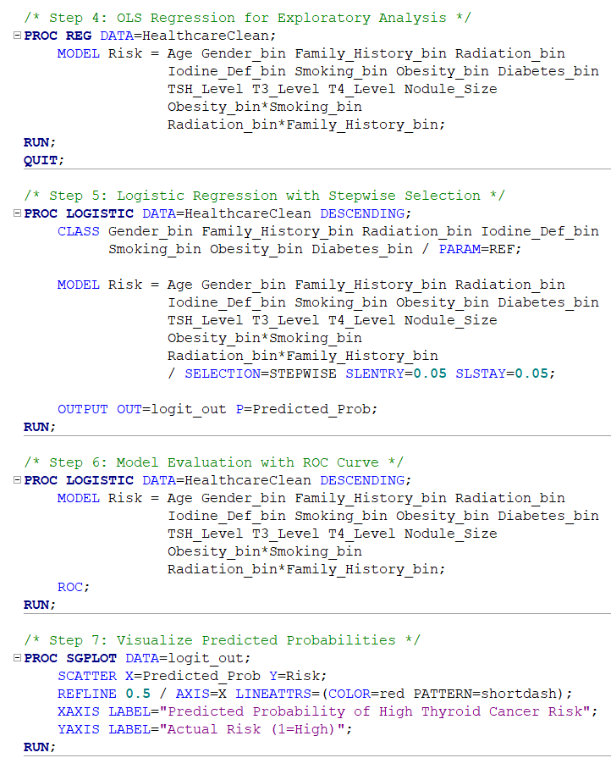
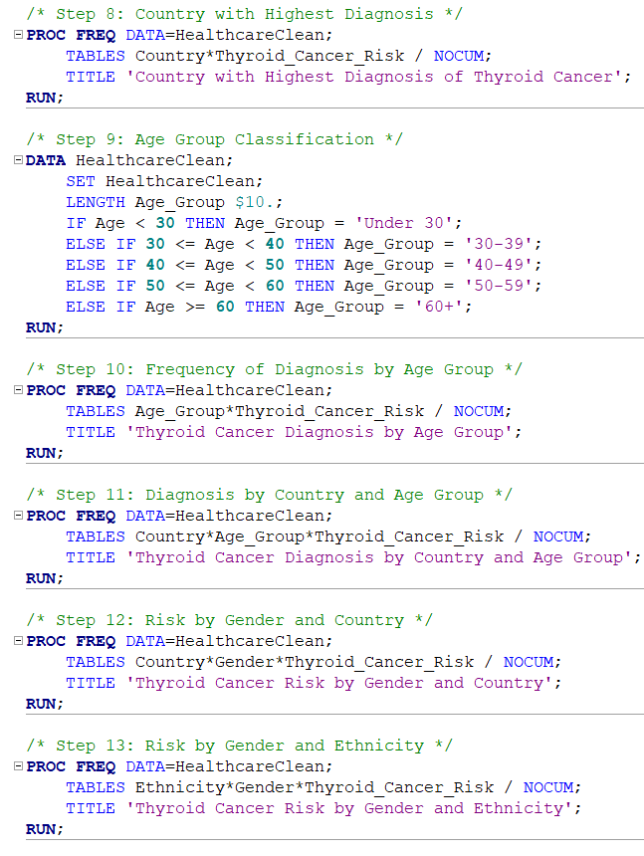
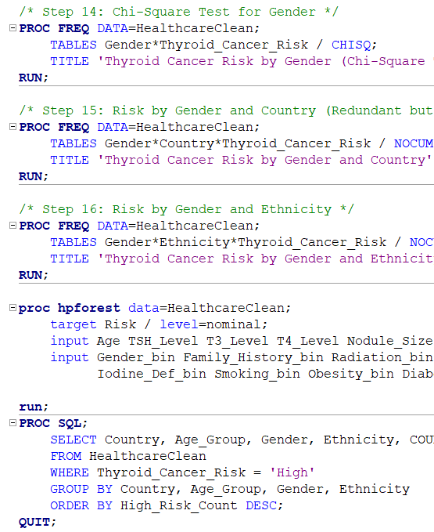
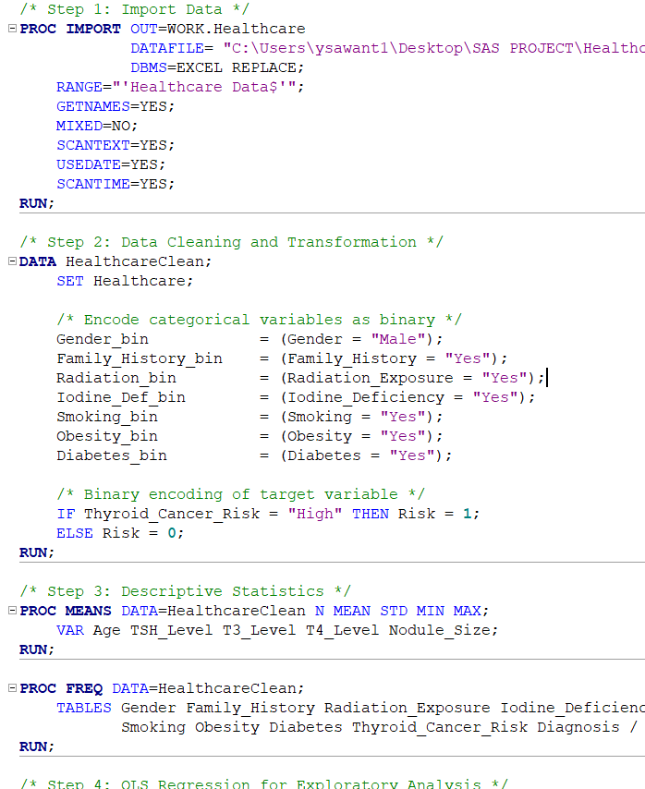
SAS Code:

Slide 15

Thank you

